Slide 1








Study of Transcriptional and Post-transcriptional Regulation in Immune Systems
Xiang Li
05/31/2023
Notes:
Hello everyone, thank you so much for being here today, Especially for your time spent to make this interview possible.
My name is Xiang, I am very lucky to present the major components of my research.
The “Study of transcriptional and Post-transcriptional Regulation in Immune Systems”

Slide 2
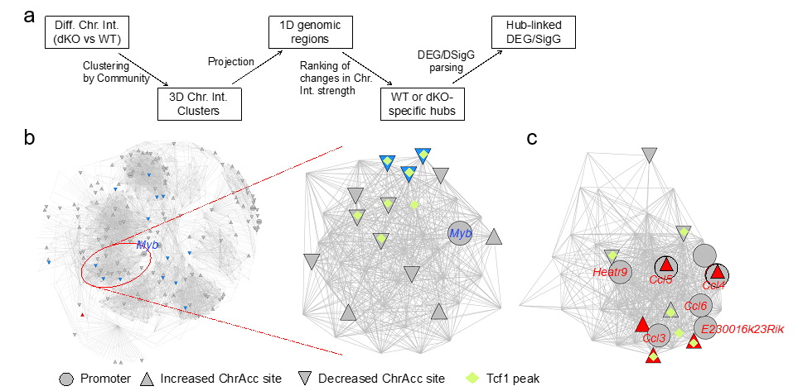
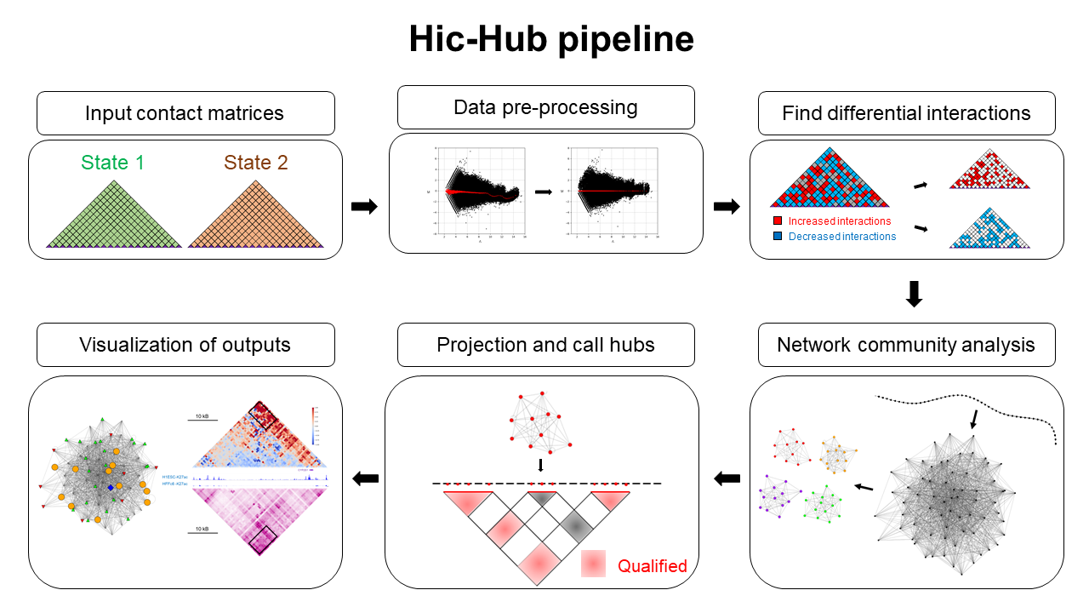
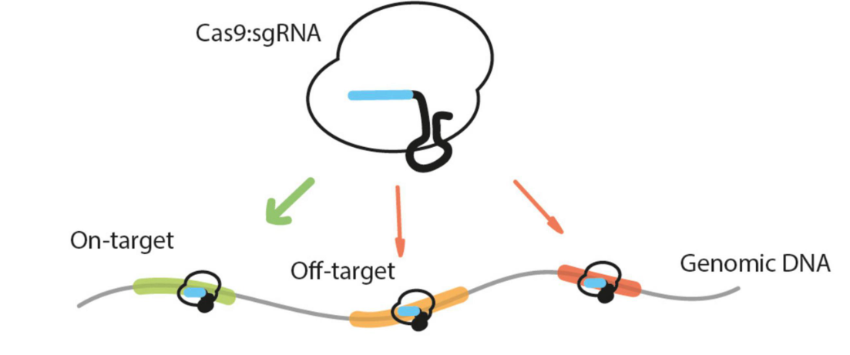



Highlights
PhD:
Transcriptional regulation in T cells
Tcf1 and Lef1 orchestrate genomic architecture to supervise mature CD8+ T cell identity and function. Qiang. S†, Xiang Li†, ..., HH Xue, Nature Communication (Oct 2021)
Tcf1-CTCF cooperativity shapes genomic architecture to promote CD8+ T cell homeostasis. Qiang. S†, Shaoqi. Z†, Xiang Li, ...,, Revision Nature Immunology (Nov 2022)
Tcf1 and Lef1 transcription factors are required for the immunosuppressive function of regulatory T cells Xing S., Gai K., Xiang Li,..., HH Xue, J Exp Med (2019)
Computational Study
Application for Network analysis in 3D Genome: HiCHub (submission)
Post-transcriptional regulation in T cells
Transcriptome-wide stability analysis uncovers LARP4-mediated NFB1 mRNA stabilization during T-cell activation. Tian Y.†, ZZ.†, Xiang Li†, ..., Zhu J. Nucleic Acids Research (2020).
Industry:
Guardant Health: Patent filed, Tumor fraction predictor basing on sequencing features
Sana Biotechnology: Workflow development for cell characterization.
GentiBio: Workflow development for cell characterization.
Collaboration: (Algorithm & Data analysis support)
Investigation of the regulatory mechanisms of LARP4 in naïve CD4+ T cells (in collaboration with Professor Tian Yi, Third Military Medical University)
Transcriptional regulation and epigenetic mechanisms of CD8+ T cell subset differentiation (in collaboration with Professor Shan Qiang, Institute of Systems Medicine, Chinese Academy of Medical Sciences)
Polar and Marine Research Integrated Analysis of Carbon Dioxide and Oxygen reveals Ocean Processes and Sensor Biases (revision, Yingxu Wu, Jimei University,)
Notes:
There are three directions in the past few years,
First, my PhD work, Transcriptional regulation in T cells and down the road some computational study and a python package I developed for network analysis basing on 3D genome (HiCHub), now available in PyPi. And the full scope of my research also cover part of post-transcriptional regulation in T cells, such as mRNA stability during T-cell activation.
Today I will mainly talk about the first two components. If possible, I wish to use some time that quickly go through my experience in industry and collaboration, to show my qualification for this position.

Slide 3
Background
Notes:
Okay, lets get start
First, Have you ever asked this question?

Slide 4
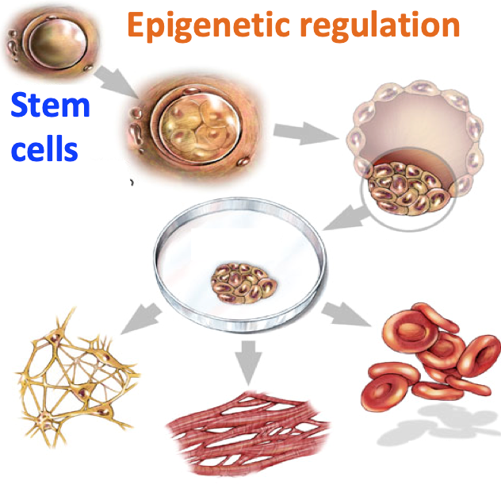
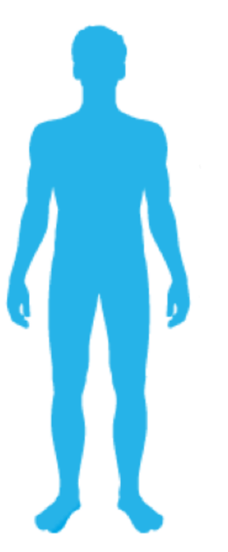




How are multitude of cell types formed?
…ATGCCCAGT…
Lymphocytes vs Pathogens
…ATGCCCAGT…
~200 TYPES of CELLS
CD8⁺ T cell: killer cells
…ATGCCCAGT…
> 30 TRILLION CELLS TOTAL!
https://www.eurostemcell.org/cell-identity-and-reprogramming
Notes:
Have you ever asked this question?
Everyone of us begins our adventure from a fertilized egg.
It is fascinating that Even though these cells all share the same genome sequence (ATGC) from that egg.
we now end up around 200 types of cells with different shapes and functions in our body.
Such as the lymphocytes involved in adaptive immune system. The only reason we can survive in a world full of pathogens,
It is because our adaptive immune system work
day and night to develop a variety of specialized cells and eliminate invaders through systematic cooperation.
For instance, the cell in our study
is one important player in this system, CD8+ T cells, also known as the killer cells. (They are able to directly kill virus-infected cells)
From a stem cell, how did we even get a CD8 T cell?
Long story in short:
Cells gain their identity by turning particular genes on and off and function differently.

Slide 5
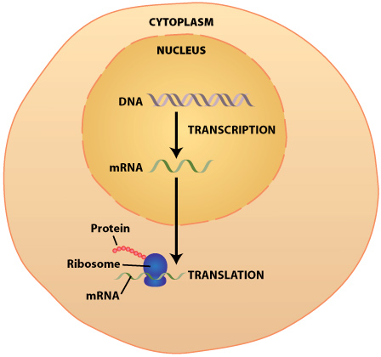
Cell Identity is determined by Gene Expression
Same Genome
Epigenome
Different Expression
(Transcriptome)
Epigenome serves as the bridge
between genome and expression(transcriptome)
Ref: https://sites.duke.edu/apep/module-2-the-abcs-of-intoxication/biology-and-chemistry-connections/dna-transcription-translation-synthesis-of-proteins/
Notes:
And you might ask how does a cell decide to turn genes on and off?
Let step into a single cell and take a close look.
Once again, the question is what cause difference for the same genome sequence?
As it is shown here, following central dogma, inside cell nucleus, some forces give instructions to transcript genetic information from DNA into mRNA
then translated into a functional product, a protein.
(Similar like the factory, for same raw material, different production line will produce significantly different outcome.)
In other words, for the same genome the epigenome is different, then you have different expression.
Epigenome serves as the bridge between genome and gene expression.
Epi means on top of, to understand the regulation on top of the genome
…….,
let’s take zoom in a little bit further and walk into the nucleus.

Slide 6
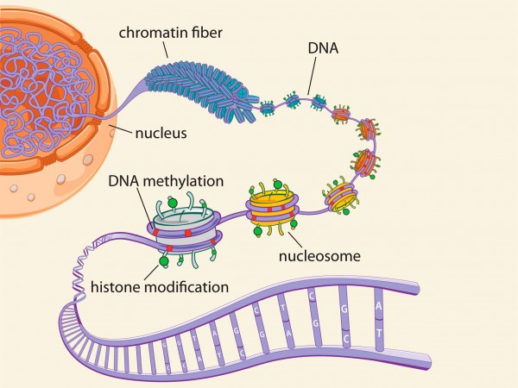
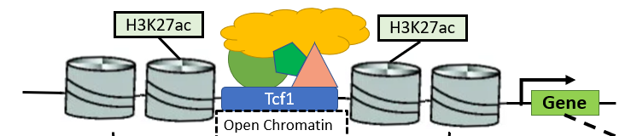
The Epigenome Components
Transcription factor (TF)
Open chromatin
Histone modification
H3K27ac, mark active regulatory elements
Genome Structure
Gene expression
C
A
G
G
G
T
TF
https://www.aguisanda.com/kitchen-table-science/2015/02/18/the-epigenome
Notes:
Epi in here means on top of, to understand the regulation on top of the genome,
….
let’s take zoom in a little bit further and walk into the nucleus.
The components of Epigenome is summarized in this map.
On top of genome sequence, the genome is organized into hierarchical levels,
from large scale to chromatin fiber to the fundamental unit nucleosome.
Each nucleosome consists of 8 histone proteins wrapped with DNA.
And these histones and DNA can be chemically modified and carries information.
It is believed this information can determine the outcome of interacting proteins (such as Transcription factor), open chromatin sites and other regulatory events.
For example, a transcriptional control can happen in many places, just like the model shown here,
In a regulatory region near the gene, a transcription factor can make chromatin open, recruiting other regulatory elements,
modifying the state of histone and regulating gene transcription.
……
And According to many studies made in the past decades,

Slide 7


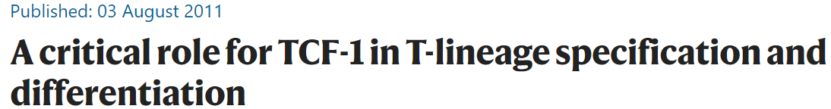
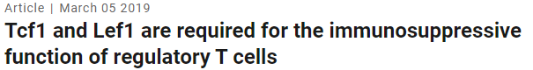
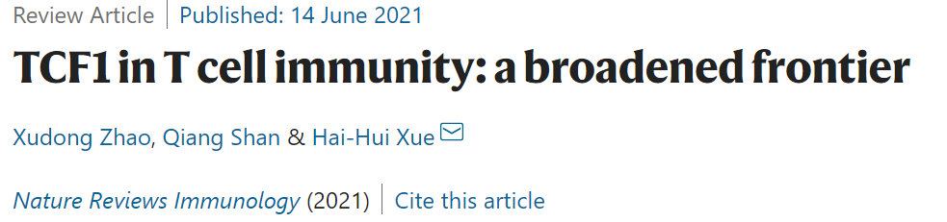
Tcf1/Lef1 is essential for T cell
Start of Gene
Transcription Control
(Weber, B. N. et al, Nature 2011)
(Hai-Hui Xue et al, JEM. 2019)
(Hai-Hui Xue et al, Nature Reviews Immunology, 2021)
Notes:
According to many studies made in the past decades
…
The Cell identity is established by lineage-determining factors,
such as transcription factors Tcf1(encoded by gene Tcf7) and its homologous protein, Lef1
They were shown to play essential regulatory roles in T cells.
For example, During T cell development,
Tcf1/Lef1 contribute the T-lineage specification and differentiation,
Required for immune function of regulatory T cells,
However, At late stages of T cell development, how the cell identity is maintained remains unknown.
…
In this presentation, I hope to focus on Tcf1/Lef1 in mature CD8 T cells as one template
to illustrate how cell identity is maintained through transcriptional control.

Slide 8

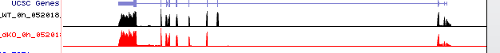

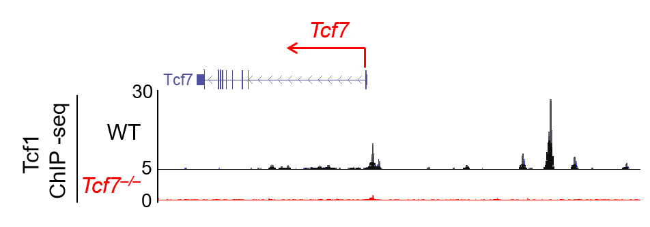
Experimental Setup and Tcf1 Knock Out Validation
Tcf7
2000
Tcf7
RNA-seq
Wild type
(WT)
2000
WT
0
vs
Double knock out
(dKO)
Tcf7/Lef1
dKO
Notes:
In this presentation, I hope to focus on Tcf1/Lef1 in mature CD8 T cells as one template
to illustrate how cell identity is maintained through transcriptional control.
……
The brief experimental setup is such, to compare the difference caused by Tcf1 deficiency.
We prepared two groups of mouse.
One is WT(normal) while the other is Tcf1/Lef1 knock out (also called double knock out for this group.)
We first validate expression of gene Tcf7, measured by RNA-seq. It is clearly the second exon was knocked out and so that the full-length Tcf1 protein cannot be produced.
To Further validate on dKO group, we used the full length Tcf1 antiserum for ChIP-seq on WT and dKO groups.
And if it was successfully deleted, no interaction between Tcf1 and genome should be observed.
In other words, in Tcf1 ChIPseq tracks shown here, the peak signals in WT should be diminished in dKO.
With high confidence from strong signal to noise ratio, Tcf1 was successfully deleted. Just shown like the sites I highlight.
Then, to define the impact of Tcf1/Lef1 deficiency on CD8⁺ T cell,
…
A Genome-wide RNA-seq analysis was performed.

Slide 9
Transcriptome Analysis (RNA-seq) shows Tcf1/Lef1 maintain CD8 T cell identity
Notes:
To define the impact of Tcf1/Lef1 deficiency on CD8⁺ T cell biology,
…
A Genome-wide RNA-seq analysis was performed between WT and dKO.

Slide 10
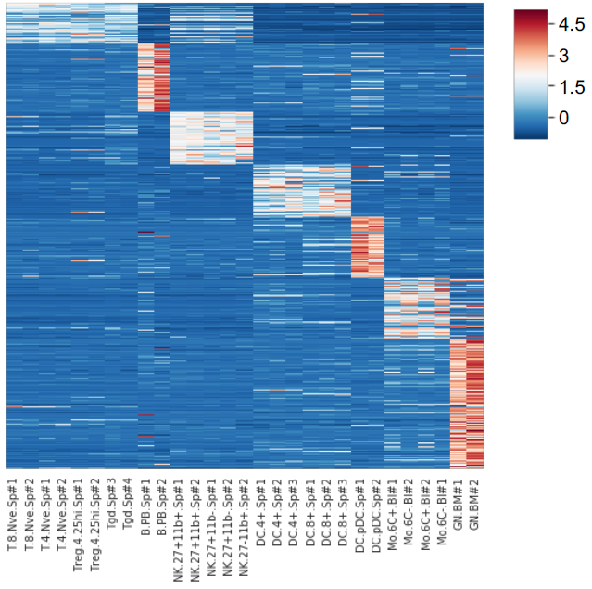
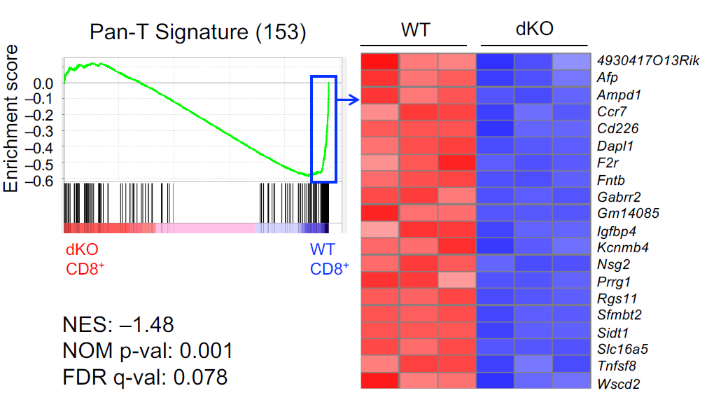
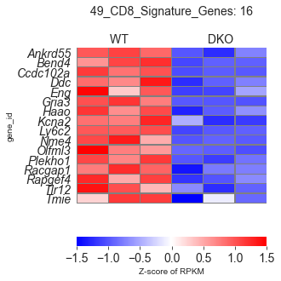
Tcf1/Lef1 are required for promoting T signature genes
Wild type (WT)
dKO
Signature Genes Cluster
Gr Mo DCs NK B T
Extract a panel of signature genes from published immune cell atlas.
And Compare expression pattern in our systems with those signature genes cluster.
T B NK DCs Mo Gr
Data from (Yoshida, Cell, 2019)
Notes:
Genome-wide RNA-seq analysis was performed between WT and dKO.
…
Combining with other RNA-seq data from a study that characterized 86 immune cell populations in mouse.
From certain immune cell types, such as T cell (including CD8, CD4 and Treg cells) and B, NK, DC, monocytes and granulocytes.
We took a simple algorithm to extract signature genes, summarized in this heatmap.
Here, Each row represents a gene with expression value in different cell types,
for instance, the genes in this cluster is define as the T signature genes.
Then, we used gene set enrichment analysis (GSEA) to assess the behavior of each cluster in two groups. Summarized in the right panel.
In this plot, the y axis represents the enrichment score and green curve shows the cumulative value, where close to the right means these genes are more expressed in WT.
Such as for T cell signature genes, the majority of genes enriched in WT and the top 20 enriched genes and their behavior in each three replicates are shown here.
After z score normalization, it is clear the expression of these genes are significantly reduced in dKO, means these genes were promoted by Tcf1.
…
And the following example is B signature genes, on the opposite, the gene set is enriched in dKO.
And surprisingly, not only B cells, all non-T cell signature genes were significantly increased in dKO, which shows these gene were strongly repressed by Tcf1.
…

Slide 11
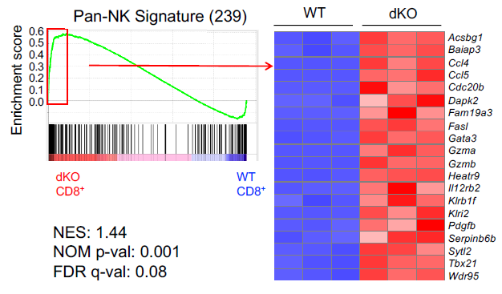
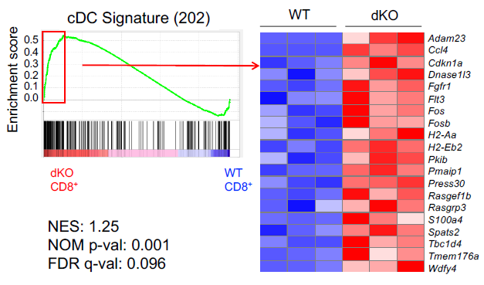
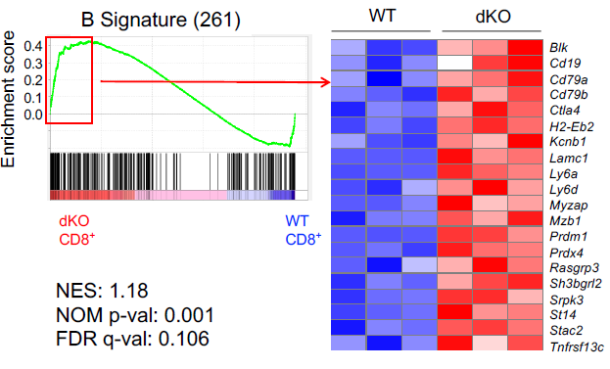
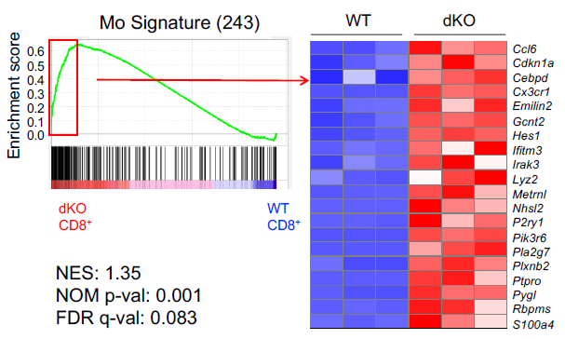
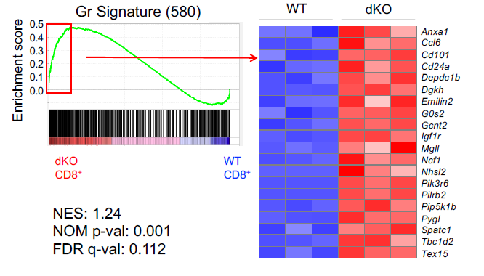
Tcf1/Lef1 are required for repressing non-T signature genes
Wild type (WT)
dKO
Notes:
And the following example is B cell, on the opposite, B signature genes is enriched in the other side.
And surprisingly, not only B cells, all non-T cell signature genes were enriched in dKO, which shows these gene were repressed by Tcf1. Such as NK, DC , Mo and Gr.
These observations suggest that in mature CD8⁺ T cells,
Tcf1/Lef1 TFs are required to maintain CD8 T cell identity through promoting T signature genes,
And repressing non-T cell lineage associated signature genes.
…
The next question is:

Slide 12

How is TCF1/LEF1 able to do this?
Notes:
The next question is:
How is TCF1/LEF1 able to do this?
To understand how these genes are regulated through Tcf1.
Let’s go back to transcriptional control model.
In a regulatory region near the gene, a transcription factor (such as Tcf1) can make chromatin open, recruiting other active regulatory elements,
modifying the state of histone (such as H3K27ac) and regulating gene transcription.
Each term I mentioned here corresponds one type of data and
combined these data, it can help us study the transcriptional control mechanism.
To begin with, we first examine the impact of Tcf1 on chromatin accessibility.

Slide 13
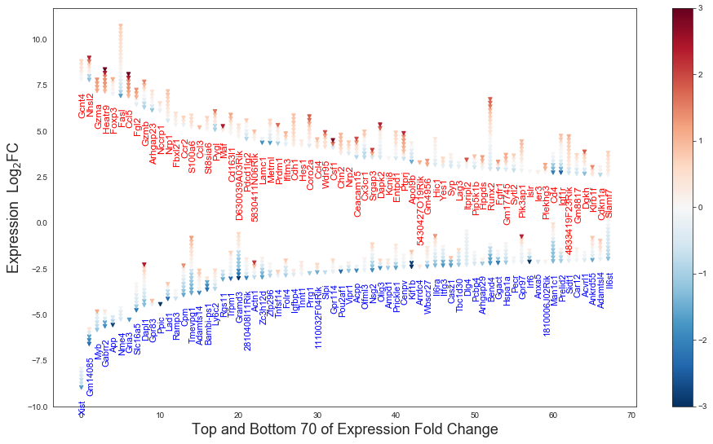
Upregulated(down) genes are enriched with increased(decreased) Accessibility sites
Notes:
To begin with, we first examine the impact of Tcf1 on chromatin accessibility.
…
In here, I took a gene-centric approach, I selected top differential expressed genes, separated in two groups by direction of change.
Each gene is annotated in this picture and the height of each gene along y axis shows the fold change of gene expression.
And Gene associated open chromatin sites are draw as a stack of triangles on top of each gene name.
For each triangle, the color shows the fold change of chromatin accessibility, such as the red color means increased accessibility in dKO.
As you can see, such as the top group of genes, these upregulated genes are more enriched with increased accessibility sites. For the bottom group, vice versa.
This observation is as expected, the chromatin accessibility correlates with gene expression.
It also shows that the Tcf1 can both increase and decrease chromatin accessibility for different sites.
…
Why is that?

Slide 14

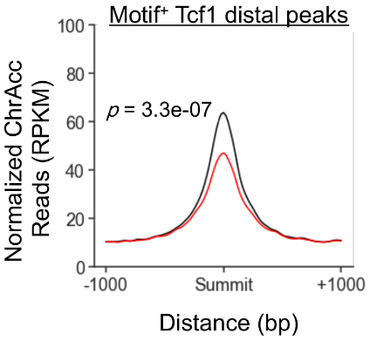
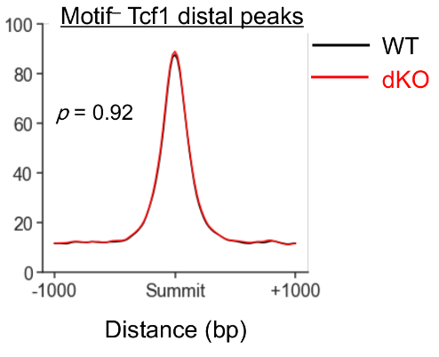
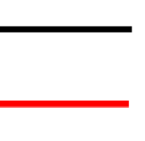
Tcf1 Direct Bindings Affect Chromatin Opening
Gene TSS
Gene TSS
Factors
Others
Tcf1 Direct Binding
Tcf1 Indirect Binding
Notes:
Why is that?
…
Worth to mention, we find that different binding modes of Tcf1 have distinct impact.
Tcf1 can directly bind into regions with specific matched sequence, called Motif.
And Tcf1 can also bind some regions indirectly through other factors.
To study the difference of binding mode.
I examined ChrAcc around Tcf1 peaks (such as 1 kb extend with respect to peak summit),
As you can see, the y axis shows accessibility strength with respect to distance.
For the sites with Tcf1 direct binding, Chromatin Accessibility are more likely to decrease upon dKO.
whereas that at indirect binding sites, they are similar on average.
These data indicate that direct binding of Tcf1 tend to maintain chromatin at open state. while indirect binding suggests more complex interaction. Which partially answer the previous question.
My original plan in here is to introduce more works such as Histone modification association with expression, co-binding events and so on.
For time concern, I will skip these works and more detail about binding mode will be talked later.
…
So far, all these works are focusing on the impact close to nucleosome level

Slide 15
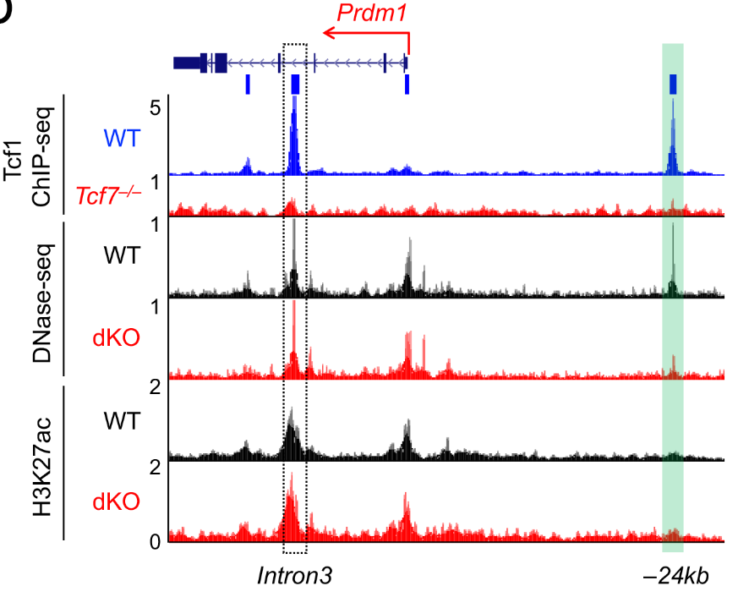
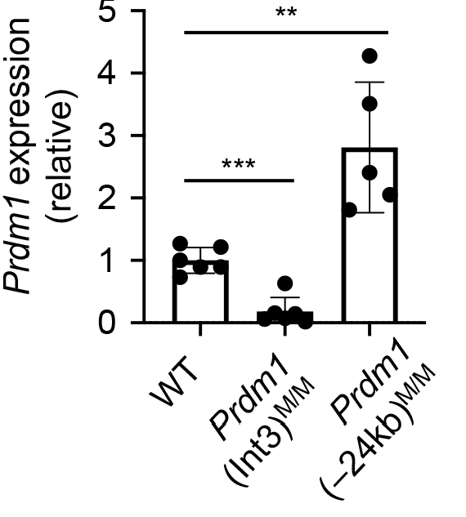
Validation of Silencer/Repressor: Prdm1
Prdm1 (encoding the Blimp1 TF that promote effector T cell differentiation)
Notes:
Data suggest may act as Tcf1/Lef1-dependent transcriptional silencers/repressors.
We focused on the Prdm1 gene, which was upregulated in dKO CD8⁺ T cells.
The Prdm1 locus contained at least two high-confidence Tcf1 peaks,
one at the –24 kb upstream of Prdm1 TSS and the other in intron 3, and both Tcf1 binding sites exhibited strong chromatin accessibility in WT CD8⁺ T cells.
We have previous targeted each site in germline using CRISPR/Cas9 approach
and generated Prdm1(–24kb)^{M} and Prdm1(Int3)^{M} alleles separately.
Interestingly, Prdm1(–24kb)^{M/M} naïve CD8⁺ T cells showed elevated Prdm1 expression than WT cells,
supporting the notion that the Prdm1 –24kb site is a Tcf1/Lef1-dependent transcriptional repressor element.
In contrast, Prdm1 expression was reduced in Prdm1(Int3)^{M/M} compared with WT CD8⁺ T cells,
suggesting the Prdm1 intron 3 site functions as a Tcf1/Lef1-independent transcriptional enhancer to support basal Prdm1 transcription in naïve CD8⁺ T cells.

Slide 16
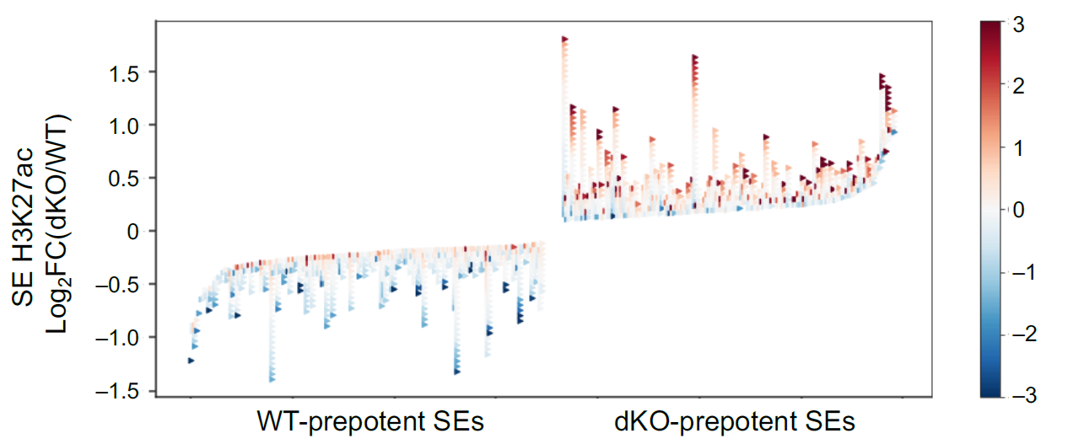
H3K27ac Identified Super Enhancer
Notes:
C)
ChrAcc at distal Tcf1 direct binding sites decreases upon loss of Tcf1 and Lef1. Motif⁺ Tcf1 direct and Motif– Tcf1 indirect binding sites were identified in Tcf1 peaks in distal regulatory regions (>1 kb from TSS), and then analyzed separately for aggregated ChrAcc profiles in WT and dKO CD8⁺ T cells. The statistical significance was calculated using one-sided Wilcoxon signed rank test.

Slide 17
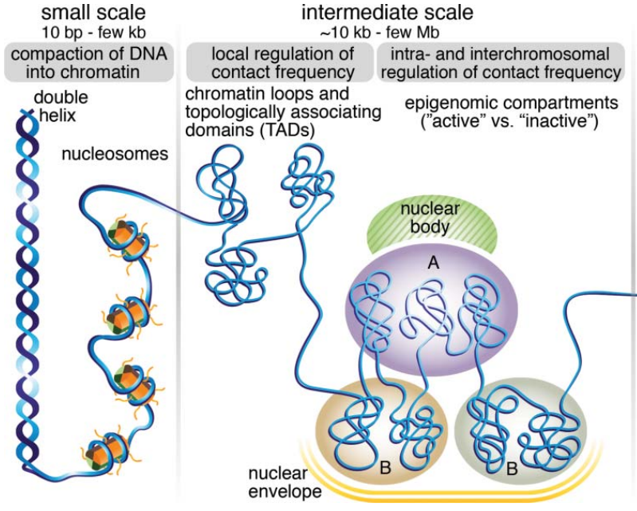
Tcf1 Affect Genome Structure at multiple scales
https://www.tandfonline.com/doi/full/10.1080/19491034.2017.1389365
Notes:
All these works are focusing on the impact close to nucleosome level.
…
Another important question is that will Tcf1 also impact on large scales, the genome structure.
Yes.
From the fundamental unit, nucleosomes, chromatin can be further organized into different levels,
Such as chromatin loops, topologically associating domains (TADs) and A/B compartments. corresponding to “active” and “inactive” chromatin.
We studied these hierarchical levels and each level reflects the correlation between structure and function.
…
First how to measure the structure of genome?

Slide 18
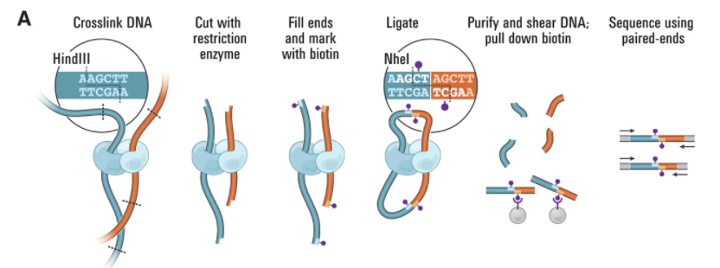
Workflow of Hi-C
Notes:
We studied these hierarchical level and each level reflects the correlation between structure and function.
…
First how to measure the structure of genome?
Here is the workflow of protocol HiC, basically first crosslink DNA that are physically close, then cut with restriction enzyme
Fill ends and mark with biotin then ligate and sequencing.
…
And the data we generated is typical looks like these:

Slide 19
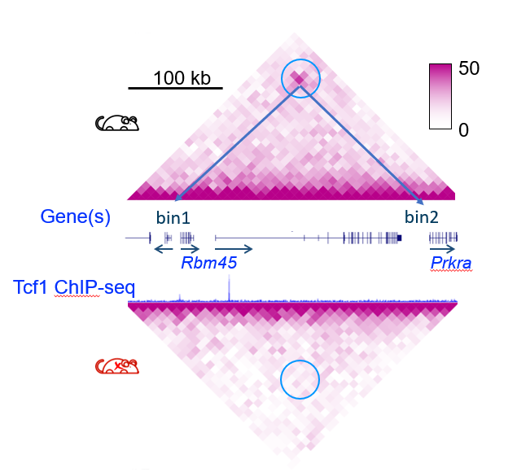
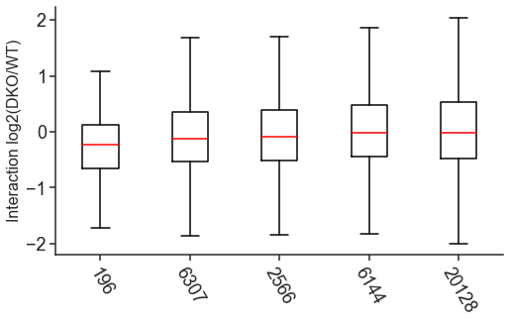
Genome Structure Changed in Looping
p=3.0e–7
p=4.7e–24
2
1
Chr Loop Changes
Log₂(dKO/WT)
0
–1
–2
Tcf/Lef Motif
+
Tcf1 peak
localization
both anchors
Control
Chr Loop
numbers
196
6,307
20,128
Notes:
And the data we generated typically looks like these,
…
displayed in the left panel. A contact matrix is used as a representation for genome structure.
Simply speaking, the pixel here represents the interaction strength between bin1 and bin2.
For time concern, please allow me quickly go over several results in different scales,
For example, here shows a chromatin loop linking two genes in WT, with a Tcf1 peak at the Rbm45 promoter,
This interaction was gone in dKO.
And a genome-wide comparison summarized in the right boxplot, divided into three columns,
First column is the looping with Tcf1 direct binding in both anchors. second only shows in one anchor,
the third shows all loopings, serve as the control group.
The conclusion is more Tcf1 peaks being deleted means more lost of interaction.

Slide 20
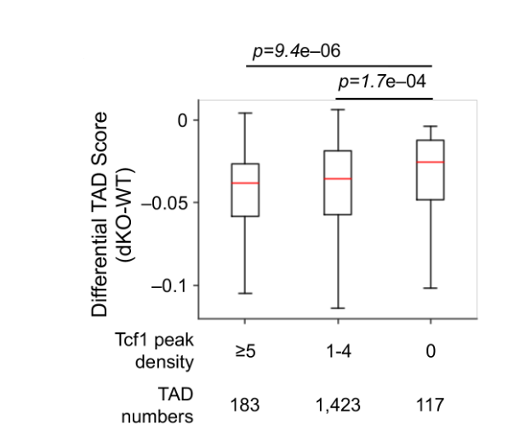
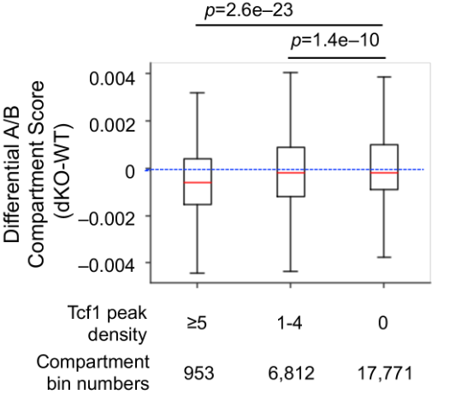
Tcf1/Lef1 Promote Chromatin Interactions at Multiple Scales
Difference = -
Notes:
More Tcf1 peaks being deleted means more lost of interaction.
…
Similar observation were also found in large scales such as topologically associating domains (TADs) and A/B compartments.
However, these association studies is generally easy to be diluted by the wide genome range. Such as TAD are generally in the level of Mbps.
And comparing with other features, such as open chromatin sites, which is just a few hundred bps.
…
It is very tricky to find a straightforward representation between large scale structure and regulatory elements.

Slide 21
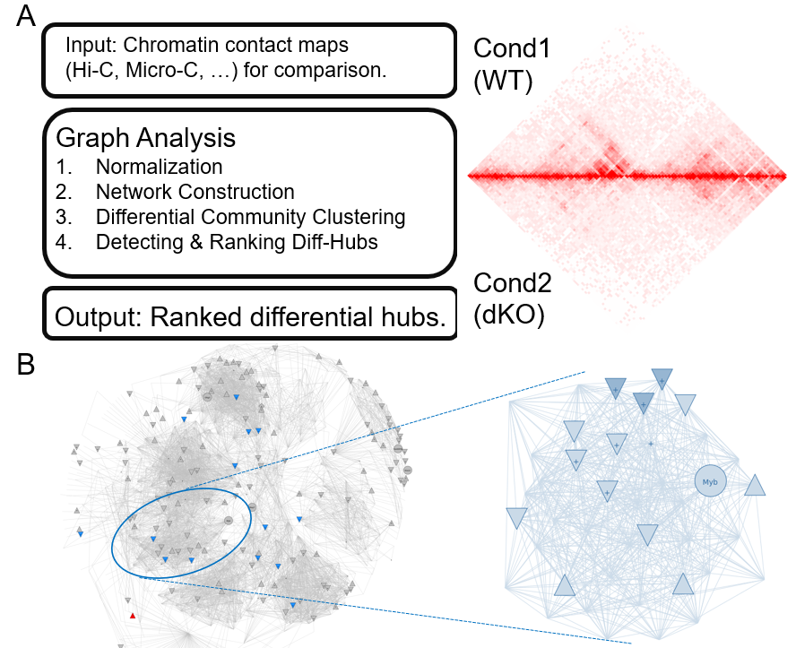
Introduction of Analysis Workflow
Later became HiCHub
(https://pypi.org/project/hichub/ )
21
Notes:
To overcome these challenges and highly take fully advantage of genome structure information in epigenome analysis.
I developed a pipeline and turns out it can greatly improve the accuracy and efficiency of our multi-omics approach,
(this pipeline finally became a tool called HiCHub), which can integrate every epigenomics data into a network and practice comprehensive analysis with high computing efficiency.
In short, we convert contact matrix into a graph, and annotated each node with genomic features, such as gene promoter, open chromatin, binding proteins and others.
And to connect structure with functionality, one of the key key component of this tool
is to identify differential hubs, defined as the region of genome structure change. Then Rank by the significance of change.
As a result, a wide range of structure alteration can be found.
…
After I implemented this tool in our system

Slide 22
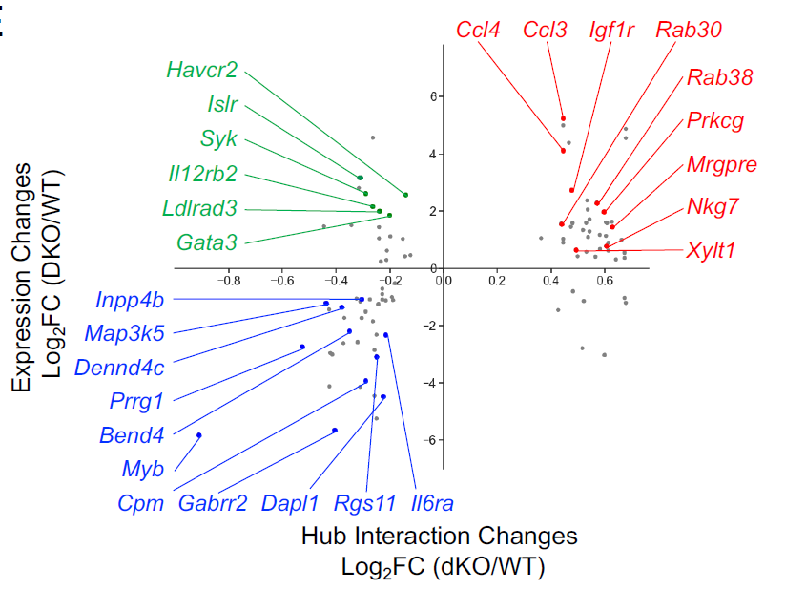
Hub interaction changes vs gene expression changes
(Signature Genes of Monocyte, DC and NK)
(Signature Genes of NK, Granulocyte and DC)
Interaction -
Expression +
Interaction +
Expression +
2
1
3
4
Interaction -
Expression -
(Signature Genes of Pan T cells)
Notes:
…
After I implemented this tool in our system
..
and conduct a genome wide scanning for structure change.
The result of hub with high significance of change and gene identified is summarized in this scatterplot,
It shows the change of hub against gene expression changes.
In general, different quadrant suggests different function roles.
Let me use two examples to illustrate the regulation models.

Slide 23
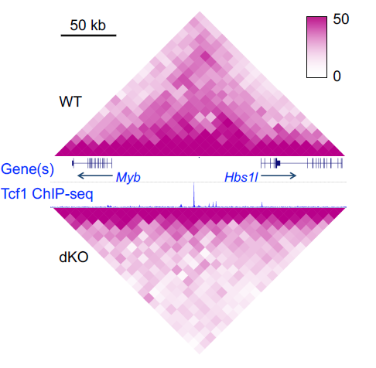
Tcf1 promote T cell signature Myb through WT specific Hub
Difference = -
40
Myb
WT
RNA-seq
40
dKO
0
# Motif 0 0 0 2 11 0
Tcf1 peaks
5
Tcf1
ChIP-seq
WT
Tcf7–/–
1
1
WT
DNase-seq
1
dKO
3
WT
H3K27ac
3
dKO
0
SE
100kb
23
Notes:
The first example is an identified top WT specific hub contains gene Myb.
Let’s have a look at the genome structure near gene Myb, It is clear that the strong interactions inside highlighted region are greatly decreased in DKO.
Combining with other data types,
Start with bulk RNA-seq, the expression of gene Myb is almost silenced.
Following Tcf ChIP-seq data shows Tcf1 bound in multiple regions and three of them were classified as direct binding by Motif matching.
And Further observation in Dnase-seq and histone modification shows multiple open chromatin in WT tend to close in dKO and gene activity marker H3K27ac also decreased significantly.
These evidences support a simple gene regulation picture.

Slide 24
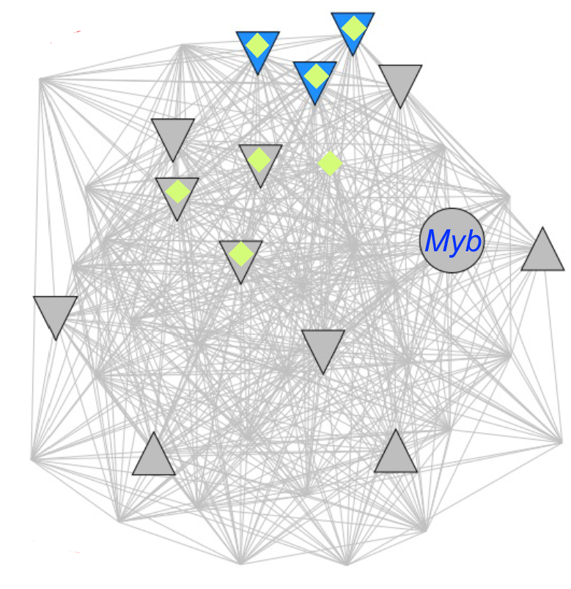


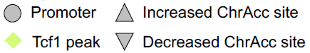
Example of WT specific Hub contains Myb
Gene TSS
Myb is necessary for effector CD8⁺ T cell
expansion in response to viral infection
Tcf1 Motif
Tcf1 Direct Binding
Output From HiCHub
Notes:
These evidences support a simple gene regulation picture.
Which is through direct binding, Tcf1 participate the process to form a stable structure and open the chromatin for initiation of gene Myb transcription.
Once the Tcf1 was gone, the dense structure unfolded and factory production line was off.

Slide 25
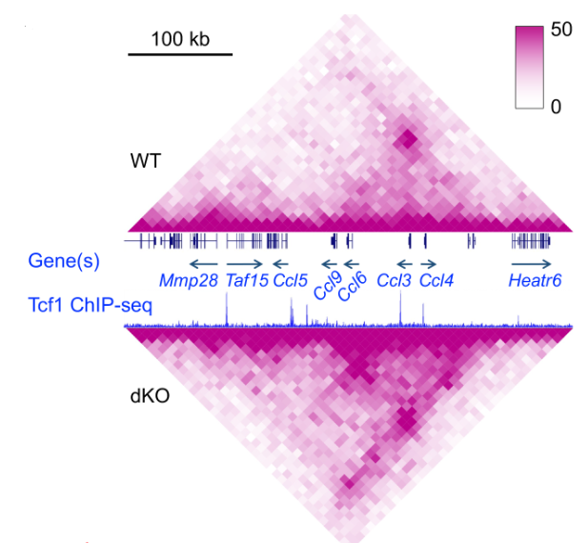
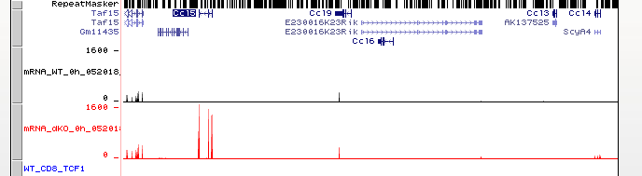
Example of dKO specific Hub contains Ccl family
Difference = -
1600
WT
RNA-seq
1600
dKO
0
Ccl5
Ccl6
Ccl9
Ccl3
Ccl4
# Motif 00 0 0 0 0
3
Tcf1
ChIP-seq
WT
Tcf7–/–
1
1
WT
DNase-seq
1
dKO
2
WT
H3K27ac
2
dKO
0
SE
100kb
Notes:
Another example is an identified top dKO specific hub contains gene Ccl family, especially Ccl5.
Look at the structure near gene Ccl5, It is clear that strong interactions are greatly increased in dKO.
Again, from RNA-seq the expression of gene Ccl5 is almost shut down in WT.
Combining with other data types, Tcf1 bound in multiple regions and interestingly, all of them are through indirect binding.
As result, multiple sites tend to open more in dKO and H3K27ac also increased significantly.
These evidences suggest another gene regulation picture.

Slide 26
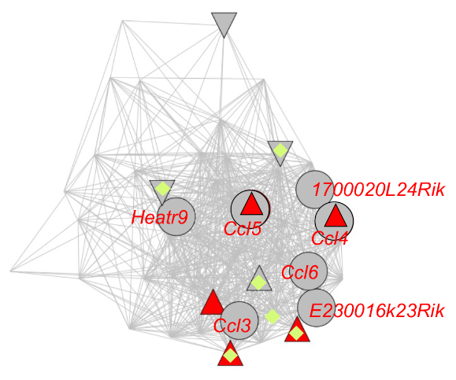
Example of dKO specific Hub contains Ccl family
Gene TSS
CCL5 induces the proliferation and activation of certain natural-killer (NK) cells
Factors
Others
Tcf1 Indirect Binding
Factors
Output From HiCHub
Notes:
These evidences suggest another gene regulation picture.
Tcf1/Lef1 is actively involved but through indirect mechanism,
Such as restrain chromatin accessibility and disengage chromatin interactions
in order to repress expression of gene Ccl5.

Slide 27
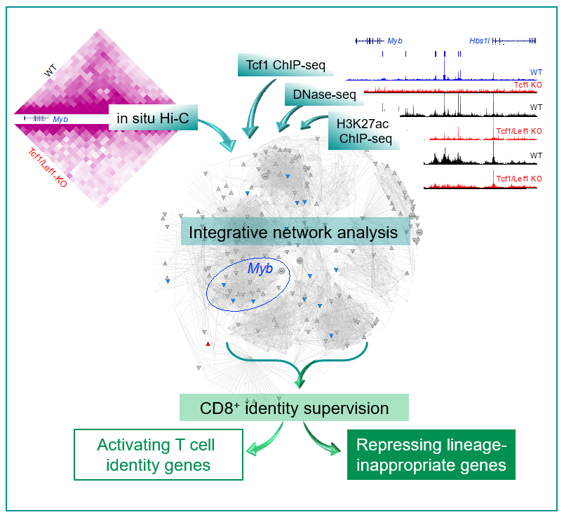
Summary
Tcf1/Lef1 provide constant supervision to CD8+ T cell identity
Tcf1/Lef1 promote and repress certain genes
Tcf1/Lef1 coordinate chromatin accessibility
Tcf1/Lef1 regulate 3D genome structure on multiples scales in CD8+ T cells
Integrative network analyses(https://pypi.org/project/hichub/ ) connect 3D genome rewiring with transcriptional output.
Notes:
This work published in nature communication.

Slide 28
HiCHub
A toolset to identify differential hubs
& integrate epigenomics data
Notes:
This work is being accepted by nature communication and get published soon.
…
I introduced the demo version of HiCHub previously, it turns out that this framework offers extra power and bring more insights into our transcriptional regulation study.

Slide 29
Introduction of HiCHub Workflow
https://pypi.org/project/hichub/
29
Notes:
I introduced the demo version of HiCHub previously, it turns out that this framework offers extra power and bring more insights into our transcriptional regulation study.
…
Here I want to share more detail about the development process and some important technical challenges we solved.
First of all, HiCHub is now a standalone tool now and can be downloaded from github or PyPI.
…
Before that, I want to introduce the idea or motivation behind the HiCHub.

Slide 30
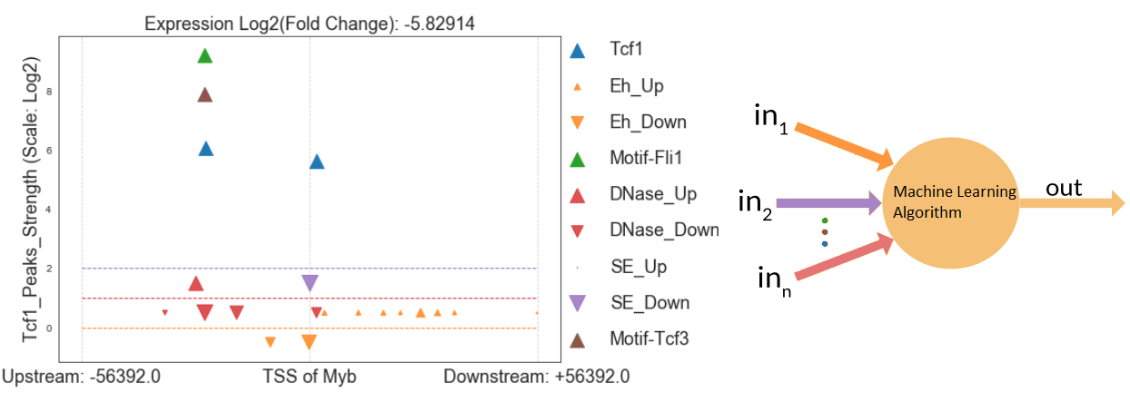
Machine Learning Framework for Regulatory Network Flat Version
Notes:
Before that, I want to introduce the idea or motivation behind the HiCHub.
In the previous work, in the conventional transcriptional regulation model, we did a lot of association studies and look at the correlation between different components. However, to understand how gene regulatory network actually works, this is far from enough. Or too time consuming.
Then, probably it was in the middle of 2018, an idea was formed in my mind, I want to create an automation system that can integrate different data sites. The ultimate goal is something like for a given epigenomic landscape, we give the transcription outcome of nearby gene.
Follow this lead, I first created a demo similar as genome browser, displayed in the left hand side. As you can see, I basically converted different data types (SE, Tcf1, Enhancer) into different rows. For a traditional ML problem, you were given a matrix with different features, and either it is a classification problem or regression problem. But generally, the format or the shape of input is fixed. (Such as in computer vision, object detection task.)
That’s why I first tried something like choose the nearest 20 elements and use that to predict the output.
As you probably expect, there could be so many options to choose which data type to include and not.
The result isn’t good.
…

Slide 31
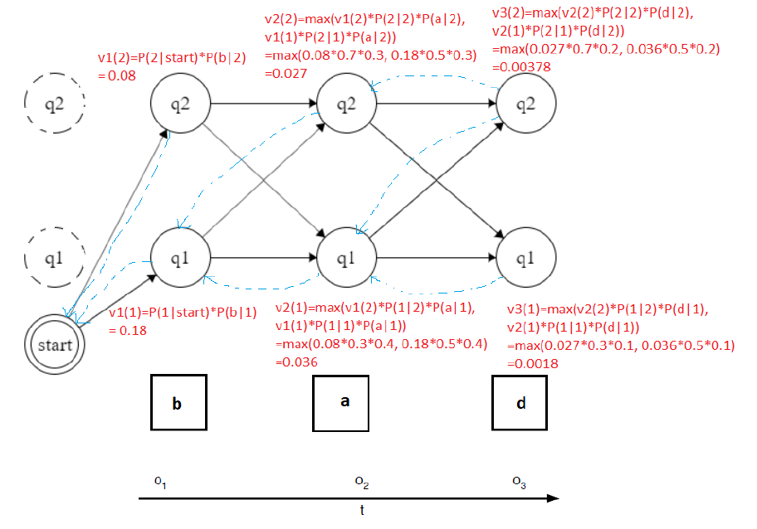
Some uncompleted Exploration (HMM)
Notes:
The result isn’t good.
…
In here, I also tried something like HMM, a model people used in NLP. (And what I did is something similar to sentiment analysis, just to use probability to predict gene expression go up or down.)
I remember it only returned good results in our target genes, but not enough to be generalized.
The exploration process is challenging and sometimes very painful.
Luckily, it is ultimately a bittersweet process.

Slide 32
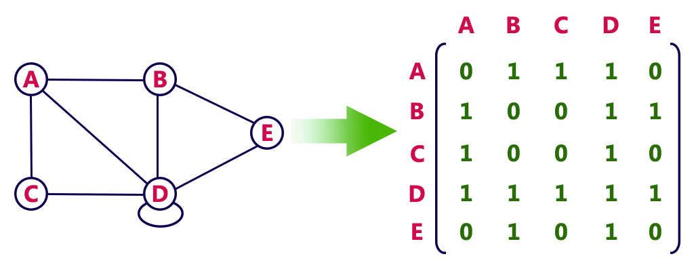

From contact matrix to graph
2
6
2
6
Notes:
Luckily, it is ultimately a bittersweet process.
…
Because the exploration process leads me to believe a good framework good for data integration, computational efficiency and close to physical reality. The graph structure.
The typical outcome contains structure information is a contact matrix, A contact matrix can be converted into a graph.
Shown here on the left panel, you can think about a chromosome being divided into 5 regions,
with the 5 nodes (A, B, C, D & E) in this graph and the contact matrix gives the weight of each edge.
Such as the interaction strength between B and E is 6.
In summary, we convert the whole genome into graphs.
Each node represents a genomic region and the connection between nodes were quantified by the element from contact matrix.
…

Slide 33
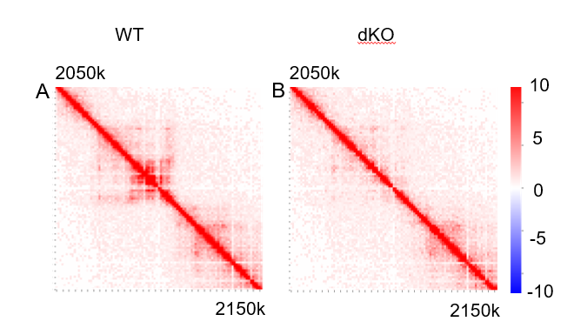
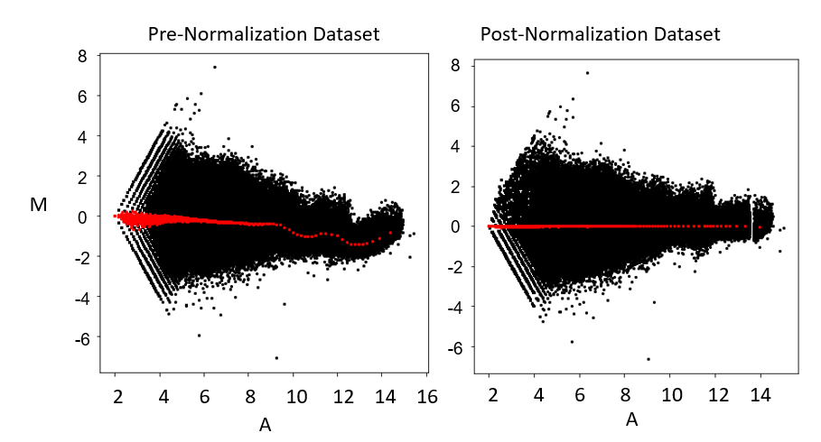
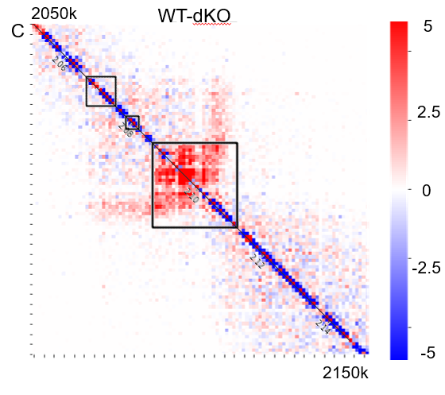
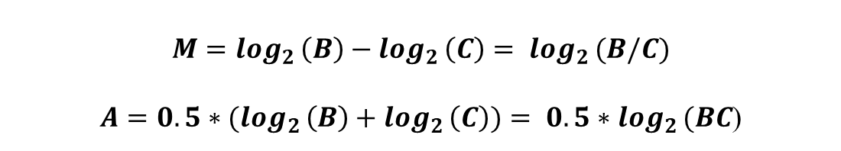
Normalization Balances different samples
$$M=\log_{2 }\left(B\right)−\log_{2 }\left(C\right)= \log_{2 }(B/C)$$
$A={0.5∗(log}_{2 }\left(B\right)+\log_{2 }\left(C\right))= {0.5∗log}_{2 }(BC$)
NORM: KR(Knight-Ruiz), ICE, VC(vanilla coverage)
Cannot apply for proper comparison
Notes:
Many studies reported to identify the fine structure of genome,
such as KR(Knight-Ruiz), ICE (Iterative correction and eigenvector decomposition), vanilla coverage.
Among them, matrix balance technique KR is widely.
However, these normalization methods were not designed for making comparison between two libraries.
MA plots from the Micro-C data pre-normalization (left) and post-normalization (right).
Each black dot represents a pair of data and each red dot represents the median value of each normalization group.
The contact heatmap shows the interaction strength in genomic region (chr10:20500000-21500000).

Slide 34
Workflow of identifying differential hubs
Genomic region
10 kB
Community
PageRank
3
5
6
1
P-value
2
4

Slide 35

Differential Hub
CTCF
Promoter
Cohensin
CTCF
Enhancer1
Enhancer2
Enhancer3
Super Enhancer
Direct Output From HiCHub
35

Slide 36



Functional genomic evidence supporting HiCHub
Chromatin landscape
Notes:
Gene Expression changes show concordant trend with interaction changes in differential hubs.
Chromatin accessibility changes show concordant trend with differential hubs.
K27ac changes show concordant trend as differential hubs.

Slide 37



Application of HicHub on MicroC
Data From: Krietenstein, Nils, et al., "Ultrastructural details of mammalian chromosome architecture.," Molecular cell, 2020.
Notes:
Figure 27: Analysis of differential hubs in Micro-C data.
A) Boxplot showing distribution of gene expression change inside differential hubs (HFFc6 & H1-ESC). One-sided Mann-Whitney U test was used for significance.
B) Stack heatmap showing the change of gene expression inside each hub.
C) Boxplot showing distribution of K27ac change inside differential hubs. One-sided Mann-Whitney U test was used for significance.
D) Stack heatmap showing the changed K27ac sites inside each hub.
E). Cell-type-specific binding of CTCF is significantly enriched in hubs specific to that cell-type and depleted in the opposite cell-type. H1-ESC-specific CTCF peaks are enriched in H1-ESC-specific hubs and depleted in HFFc6-specific hubs, and vice versa. The y-axis denotes the enrichment score, the ratio of observed count over the expected count of CTCF binding on hubs.

Slide 38

Acknowledgement
Acknowledgement:
Qiang Shan performed the experiments, with assistance from Xia Chen.
Assistance from Shaoqi Zhu, Shuang Yuan and Qing Chen.
Thank the help from supervisor Peng, and collaborator Xue.
This study is supported by grants from the NIH.

Slide 39

Summary
Notes:
This work is being accepted by nature communication and get published soon.
…
I introduced the demo version of HiCHub previously, it turns out that this framework offers extra power and bring more insights into our transcriptional regulation study.

Slide 40



CRISPR Cas System Gene Editing
Off-Target Analysis
On/Off-Target analysis protocol:
http://crispresso2.pinellolab.org/submission
Bioinformatics-Lead in building Cellular Profiling Platform: ** Deploy gentibio internal chatGPT
** Deploy AWS VC-backed startup package and build Bioinformatics Infrastructure.
** Write analysis tools (python & R) and pipeline (bash, Nextflow & Docker)
** Deployed bulk/scRNAseq/Bisulfite analysis pipeline and downsteam analysis such as: Transcript isoform expression and in-silico cell2cell interaction prediction.
Notes:
I. Build a full-stack web applications from scratch. (Automation Framework with aws)
* An automated data processing system (for heavy job that need computing instance), it integrates web application(frontend) and complex analysis workflows (backend). Anyone can do the heavy analysis with just a few clicks & get the results back from a single link. (Role Mode: Galaxy)

Slide 41

Q & A
感谢各位交大一附院的
领导前辈和行政老师的联系和帮助

Slide 42
Projects
Work in Guardant Health
Follow industrial standard, develop a module that can identify a source of rare contamination.
From sequencing feature, design a module to predict tumor fraction.
Notes:
In this 15 mins presentation, I will mainly talk about two projects that I am so lucky to work on. One is working with Ravi, the other is with Catalin.
Let’s start with first one, non-human contamination: It was first identified by Ravi in some research samples listed here, he found some mapped reads of cfDNA actually do not belong to human. And the possible sources of nonhg DNA are something like Chicken, Cow and so on. Let’s take a look at one example from many.

Slide 43

Tumor Fraction Prediction by cfDNA Fragment Size
----Supervisor: Catalin Barbacioru
Tumor Fraction Prediction
The initial exploration was in March 2018 lead by Catalin Barbacioru
Mouliere, Florent, et al. "Enhanced detection of circulating tumor DNA by fragment size analysis."
Science translational medicine 10.466 (2018).
Notes:
https://www.ncbi.nlm.nih.gov/pmc/articles/PMC6774252/
Another project is predicting Tumor fraction by cfDNA fragment size.
This work initially began in March 2018 lead Catalin. A study reported in 2018, scientist extract plasma DNA from cancer and normal cells and distinguish them by the fragment size profile of of cfDNA.

Slide 44

Prevalence of Non-human DNA in plasma
Literatures showing Non-human DNA in plasma:
“Able to break”
Complete genes may pass from food to human blood. PloS one, (2013) Spisák, S., et al
“Response encountered”
Inheritable epigenetic response towards foreign DNA entry by mammalian host cells: a guardian of genomic stability, Walter Doerfler, et al Epigenetics (2018)
A. Life and death of circulating cell-free DNA. Cancer Biol Ther. (2019) Kustanovich A., et al.
“Impact after outbreak”
Foreign DNA in food invades the organisms’ cells and can lead to stochastic epigenetic alterations with a wide range of possible pathogenetic consequences. Doerfler, W. Clin Epigenet (2020)
Cow
Sheep
Pig
Horse
Cat
Dog
Human
Rabbit
Rat
Mouse
*Chicken
*Fish
Notes:
In here, we did some literature studies.
Before go into detail,
I want to share a history of a virus, the data suggests that the first patient started around 1920, and after 60 years, after hundreds of lives lost, and thousands were suffering, in September 1982, the CDC for the first time, define it as 'AIDS'.
We believe this could be something similar, from literature study,
It is shown that non-human DNA is able to break into our cells barrier.
And normally the immune system should eliminate the invaders.
And in some rare cases, it did not work properly and lead non-human DNA outbreak. This could be some dysfunction disease just like AIDS.
And many questions such as direct impact from outbreak on patient’s health? Does this mean something for choosing our diet, such as don’t eat animals that are close to us? And are these Nonhg DNA inheritable?
And I personally believe that Guardant health might be the most promising adventurer in the world to first approach the truth of this question, because the data.
##As you probably noticed here, this figure shows most food are very closely related to human.

Slide 45


Integration into BIP4.0 under bip-nonhumanfilter
SNV/INDEL Variant Caller
non-human filter
The bip-nonhumanfilter module takes the output from the SNV/INDEL caller and flags the variants for non-human DNA
Diagram of BIP4.0
Notes:
To solve the first task, we built a module called non-human filter, this module at first took around more than 24 hours in some rare cases, basing on team efforts, now we can optimize that case to less than ~25 mins with 8 cores.
Several round tunning were done, now it is almost ready to integrate to BIP4.0.

Slide 46

Difference of size profile between healthy patients and cancer
1. Differences in fragment lengths of circulating DNA could be used to enhance sensitivity for detecting the presence of ctDNA.
2. Fragment size analysis and selective sequencing of specific fragment sizes can boost ctDNA detection and provide an alternative to deeper sequencing of cfDNA.
344 plasma samples from 200 patients with cancer.
Mouliere, Florent, et al. "Enhanced detection of circulating tumor DNA by fragment size analysis."
Science translational medicine 10.466 (2018).
Notes:
And infer the fragment size profile of of cfDNA.
And after they comparing 344 plasma samples, the result is shown in the right hand side, the gray lines represent group with High tumor fraction and yellow lines stand for Low.
A clear difference is observed. Basing on this idea, we proposed a hypothesis that by focusing on certain important genomic regions, the difference will stand out more clearly.
In other words, we can use probes-level fragment size to predict tumor fraction.

Slide 47



Simple setup of neural networks for test
= 29,674(probes)
*
500
Notes:
p(density) * 64 * 12758 * 500 || multiply 64 || *12758
The best way to work with large noisy data is probably deep learning framework.
Here is the simple setup of our approach.
In summary, we had ~500 training samples and a completely separate ~500 samples as testing.
Each training sample looks like this, # of probes * fragment size density in 500 bps region.
Put them into some model of neural networks and training. And using the trained model to predict TF for test data.
To achieve this goal in an efficient matter, there are two components we can improve, first is the training data and the other is model itself.

Slide 48


Preliminary setup outperforms study reported
Our approach has an enhanced performance (Pearson correlation coefficient between predicted tumor fraction and max_maf = 0.83), when compared to other methods based on genomic coverage (0.43).
Product of competitor: Tempus
Ref: https://www.nature.com/articles/s41698-021-00202-2?utm_source=
pressrelease&utm_medium=earnedmedia&utm_campaign=xf#citeas
Notes:
After several round tuning, when we apply it to independent testing data sets.
Our approach has an enhanced performance comparing to other methods reported. As it is shown in this report, the best pearson correlation coefficient in their work is 0.43 (by on tempus test).
Currently, we can achieve 0.83 for pearson correlation coefficient between predicted tumor fraction and real values.

Slide 49

Hummingbird
Variants Calling Assay basing on Amplicon seq
Notes:
High throughput single cell DNA targeted sequencing enables detection of rare mutations in cells and identification of subclones defined by co-occurrence of mutations.
The big challenge with multiplex sequencing at single cell level is the non-uniform amplification of the targeted regions during PCR.
This results in inadequate coverage of mutations of interest in the panel and hence makes genotyping challenging.
To address this challenge, we developed a machine learning engine to optimize amplicon design for uniform amplification by making reliable performance prediction.

Slide 50

Timeline of
Human genome assembly and variants

Slide 51

Conditional targeting of the Tcf1/Lef1 gene locus

Slide 52

Human Genome Project

Slide 53


Integrated Analysis of Carbon Dioxide and Oxygen reveals
Ocean Processes and Sensor Biases
My suggestion:
Or Monte Carlo

Slide 54

Behavioral and neural mechanisms of associative learning
(Y., Cheng, Post-Doc, JHU)
Study Design:
Set an average number of push to trigger reward (food delivery)
Then each training sessions (30 mins), recording the signal of 1 (pushing) or 0 (No) with 10 ms windows.
From the binary signal, design an algorithm to analysis the data and find the certain pattern or behavior.
My solution:
For 30 mins, each windows is 10 ms. In total there is 180K (N) data points.
Set your searching window length range, such as between 6~10. (6 windows means search for 6*10ms pattern)
For example, if the number of data points is N, then convert all data from [0,6] [1,7] [2,8] … [N-6,N] to decimal (between 0 to 64). Then calculate their distribution and detect if there is any number standout.

Slide 55

Reprogramming as a model to study the barrier between
embryonic and extraembryonic lineages
Notes:
With regard to the other point, perturbingTcf1 DNA binding motif is an excellent idea, and we are interested in the same question as the reviewer. As illustrated in the diagram below, the HMG DNA binding domain starts from the 304th residue in full length Tcf1 protein.
We attempted to address this question by inserting a stop codon at corresponding exon in mouse germline. Upon analysis of the resulting mouse strain, the Tcf1-HMG truncated protein was not stable, and resulted in a null mutant as shown below.
This was reported previously in J. Immunol. (8). This observation indicates that a more subtle approach, such as specific mutation of DNA-contacting residues in Tcf1, is necessary for future dedicated investigation.

Slide 56



Trophoblasts in human placental villi
Notes:
Ref:

Slide 57


scRNASeq Analysis
Visualize cell cluster by generic marker
Notes:
The cell clusters with high expression of GATA3 were those of trophoblast origin, two generic trophoblast markers

Slide 58






Target Discovery by
Expression of Transposon Elements
Notes:
Alu elements average only a few hundred nucleotides, thus making them a short interspersed transposable element, or SINE.
Alu is particularly prolific, having originated in primates and expanding in a relatively short time to about 1 million copies per cell in humans.
In humans, these non-LTR TEs are the only active class of transposons;
LTR (long terminal repeats) retrotransposons and DNA transposons are not capable of jumping.

Slide 59
Q & A

Slide 60
Conditional targeting of the Tcf1/Lef1 gene locus

Slide 61

Cre-Lox
FLEx Switches “FLLip Excision”
Ref: https://old.abmgood.com/marketing/knowledge_base/Cre-Lox_Recombination.php
Notes:
Figure 1. Mechanism of Cre-loxP system. (A) An overview of Cre-loxP system. 38 kDa Cre recombinase recognizes the loxP sites of specific 34 bp DNA sequences. (B) General breeding strategy for conditional mutation using loxP and Cre driving mouse line. In principle, one mouse must have a tissue-specific driven cre gene and another mouse have loxP flanked (floxed) alleles of interest gene Y. Expression of Cre recombinase excises floxed loci and inactivates the gene Y.

Slide 62

LEF1-deficient mouse
Ref: Development of several oreans that require inductive epithelial-mesenchymal
interactions is impaired in LEF-1-deficient mice

Slide 63


Conditional targeting of the Lef1 gene locus
Notes:
Since germline disruption of both TCF-1 and LEF-1 was embryonic lethal,
we conditionally targeted the Lef1 gene by inserting 2 LoxP sites to flank exons 7 and 8, which encode the DNA binding domain of LEF-1.
Upon germline transmission (Fig. B), we used a Flippase transgene to remove the neomycin-resistant gene to minimize disturbance of the native Lef1 gene locus, and the resulting allele was designated as Lef1- floxed allele (Lef1 FL/+) (Figure S5C). To ablate LEF-1 protein in thymocytes at early developmental stages, we used a Vav1-Cre transgene which initiates excision of the floxed sequences in early hematopoietic progenitor cells (Ogilvy et al., 1999).
(A) Targeting strategy. Depicted on top are partial structure of the Lef1 gene with vertical lines denoting exons (all numbered), key enzyme sites, and relative locations of 5’- and 3’-probes used in Southern blotting. Shown at the bottom is the structure of the targeting vector, highlighting the targeting arms, locations of inserted LoxP sites (filled triangles in green), Frt sites (open triangles in blue), and neomycin resistant gene (NEO) cassette. Note that an extra KpnI site was inserted immediately after the upstream LoxP site, and an extra SpeI was embedded in the NEO cassette. These two extra enzyme sites were used to facilitate detection of a targeted allele by Southern blotting. (B) Identification of embryonic stem cell (ES) clones with expected homologous recombination. Genomic DNA was extracted from ES cell clones generated after 23 targeting construct electroporation and selection, digested with KpnI, and blotted with the 5’-probe, which detects the WT allele at approximately 10 kb, and the targeted allele at approximately 8 kb (top panel). Another portion of genomic DNA was digested with SpeI and blotted with the 3’-probe, which detects the WT allele at about 6 kb, and the targeted allele at about 7.5 kb. (C) Release of the NEO cassette from the targeted Lef1 allele using Flippase. Upon germline transmission, the Lef1-floxed mice were crossed with Flippase transgenic mice. Schematics on the top show the Lef1-floxed allele prior to and after Flippase-mediated excision of the NEO cassette. Shown at the bottom are Southern blotting of the progeny genomic DNA using SpeI digestion and the 3’-probe. This combination detects the conversion of 7.5 kb Lef1-targeted allele to 8.8 kb after discharge of the NEO cassette. Note that in the targeting vector as in (A), the upstream SpeI site was deliberately destroyed by inserting the Frt site. In the targeted Lef1 allele, after excision of the NEO cassette and concomitant deletion of the SpeI site in NEO, another SpeI site that is approximately 2.8 kb upstream of the Frt site was utilized by SpeI digestion. As a result, the NEO-deleted, floxed Lef1 allele was detected as an 8.8 kb band.

Slide 64

Conditional targeting of the Lef1 gene locus
Notes:
Western blotting confirmed efficient elimination of the LEF-1 protein in total bone marrow cells and thymocytes from Vav1-Cre+:Lef1 FL/FL mice (referred to as Lef1 −/−) (Figure 5B). We then used more sensitive quantitative RT-PCR to validate complete elimination of Lef1 transcripts in DN3 thymocytes from Lef1 −/− or Vav1-Cre+:Lef1 FL/FLTcf7 −/− mice (referred to as Lef1 −/−Tcf7 −/−) (Figure 5C). Lef1 transcripts were detected at much lower quantity in hematopoietic stem cells (HSCs), and deletion of Lef1 was complete in both Lef1 −/− and Lef1 −/−Tcf7 −/− HSCs (Figure 5D). TCF-1 deficiency alone substantially diminished total as well as DN3 thymocytes (Schilham et al., 1998; Verbeek et al., 1995). Elimination of both TCF-1 and LEF-1 did not cause further significant reduction in total thymic cellularity or the DN3 subset (Figure 5E and 5F), and definitive T lymphopoiesis did occur in Lef1 −/−Tcf7 −/− mice (detailed below). We have monitored a cohort of Lef1 −/−Tcf7 −/− mice along with their Tcf7 −/− littermates. All the Tcf7 −/− littermates succumbed to T-cell lymphomas by 40 weeks of age. In contrast, 10 out of 13 Lef1 −/−Tcf7 −/− mice survived the 45-week observation period without overt signs of lymphoma formation (Figure 5G). The other 3 Lef1 −/−Tcf7 −/− mice that died between 30 to 45 weeks were found to have enlarged thymi, and the malignant thymocytes showed a phenotype of CD4−CD8−CD3−TCRβ −, consistent with a complete block of T-cell development at the DN stage in the absence of TCF-1 and LEF-1 (detailed below). Thus, deletion of LEF-1 greatly delayed or prevented malignant transformation of Tcf7 −/− thymocytes.

Slide 65

TCF7 gene structure
Tcf7
2000
RNA-seq
2000
0
This selection cassette was inserted downstream of exon 2 (in intron 1) of the targeted gene, and another loxP site was inserted upstream of exon 2
https://translational-medicine.biomedcentral.com/articles/10.1186/s12967-015-0617-7/figures/1
https://www.jax.org/strain/030909
Notes:
TCF7 gene contains multiple exons.
Different splicing may transcribe to variants of mRNAs and translates to different protein isoforms.
The first promoter can generate mRNAs encoding a full-length activating form of protein isoforms which contains the β-catenin binding domain,
while the second promoter cannot and thus produce the truncated dominant-negative isoforms. Therefore, two different groups of TCF7 isoforms function differently.
This selection cassette was inserted downstream of exon 2 (in intron 1) of the targeted gene, and another loxP site was inserted upstream of exon 2
Targeting construct design: The Tcf7 gene is expressed in multiple isoforms due to different promoter usage and alternative splicing.
The full length TCF-1 isoforms (p45 and p42) are transcribed from an upstream promoter utilizing Exon 1
and the short isoforms (p33 and p30) are transcribed from Exon 3. To generate a Tcf7-GFP reporter allele,
we inserted an EGFP expression cassette and a neomycin-resistant gene (NEO) cassette into the least conserved region in the first intron of the Tcf7 gene.
The EGFP expression cassette contains a strong En2 gene splicing acceptor (En2-SA) to facilitate splicing of Tcf7 exon 1 to the reporter,
an internal ribosome entry site (IRES) to facilitate independent translation of EGFP, and the EGFP cDNA followed by poly-adenylation sequence.
Two Frt sites were inserted to flank the EGFP and NEO cassettes One LoxP site was inserted immediately downstream of the second Frt site
in intron 1 and another LoxP site was inserted into the least conserved region in intron 2.
These features, although not used in this report, were designed to remove the EGFP and NEO cassettes with Flippase, converting the Tcf7-GFP reporter allele to Tcf7 Exon 2-floxed allele, so as to conditionally target the TCF-1 long isoforms.

Slide 66
Validation of Upregulated Tcf1 production
The HMG DNA binding domain starts from the 304th residue in full length Tcf1 protein.
Ref: Xue HH et., al. Cutting Edge: β-Catenin-Interacting Tcf1 Isoforms Are Essential for Thymocyte Survival but Dispensable for Thymic Maturation Transitions. J Immunol. 2017
Notes:
With regard to the other point, perturbingTcf1 DNA binding motif is an excellent idea, and we are interested in the same question as the reviewer. As illustrated in the diagram below, the HMG DNA binding domain starts from the 304th residue in full length Tcf1 protein.
We attempted to address this question by inserting a stop codon at corresponding exon in mouse germline. Upon analysis of the resulting mouse strain, the Tcf1-HMG truncated protein was not stable, and resulted in a null mutant as shown below.
This was reported previously in J. Immunol. (8). This observation indicates that a more subtle approach, such as specific mutation of DNA-contacting residues in Tcf1, is necessary for future dedicated investigation.

Slide 67
Expression Validation

Slide 68
Validation of Silencer/Repressor: Prdm1
Prdm1 (encoding the Blimp1 TF that promote effector T cell differentiation)
Notes:
Data suggest may act as Tcf1/Lef1-dependent transcriptional silencers/repressors.
We focused on the Prdm1 gene, which was upregulated in dKO CD8⁺ T cells.
The Prdm1 locus contained at least two high-confidence Tcf1 peaks,
one at the –24 kb upstream of Prdm1 TSS and the other in intron 3, and both Tcf1 binding sites exhibited strong chromatin accessibility in WT CD8⁺ T cells.
We have previous targeted each site in germline using CRISPR/Cas9 approach
and generated Prdm1(–24kb)^{M} and Prdm1(Int3)^{M} alleles separately.
Interestingly, Prdm1(–24kb)^{M/M} naïve CD8⁺ T cells showed elevated Prdm1 expression than WT cells,
supporting the notion that the Prdm1 –24kb site is a Tcf1/Lef1-dependent transcriptional repressor element.
In contrast, Prdm1 expression was reduced in Prdm1(Int3)^{M/M} compared with WT CD8⁺ T cells,
suggesting the Prdm1 intron 3 site functions as a Tcf1/Lef1-independent transcriptional enhancer to support basal Prdm1 transcription in naïve CD8⁺ T cells.

Slide 69


Validation of Upregulated CCL5 production
CCL5 induces the proliferation and activation of certain natural-killer (NK) cells
Notes:
Validation of elevated CCL5 production by naive dKO CD8+ T cells after 5-hr treatment ex vivo with
PMA and ionomycin in the presence of Golgi Stop and Golgi Plug, by immunoblotting.
CCL5 production showed pronounced increase in stimulated dKO CD8⁺ T cells

Slide 70


Validation of Downregulated Myb production
MYB is necessary for effector CD8⁺ T cell expansion in response to viral infection
Notes:
Another example of Tcf1/Lef1-mediated concerted regulation of chromatin interaction, SE activity and ChrAcc at the Myb
dKO CD8⁺ T cells showed potent downregulation of Myb transcripts and MYB protein (Fig. 8e)
e–f. Detection of MYB expression with immunoblotting

Slide 71
Tcf1/Lef1 TFs control multiple aspects of T cell functions

Slide 72

How Tcf1/Lef1 control CD8⁺ T cell biology
Validated protein expression changes in dKO CD8⁺ T cells for select target genes
Investigated their functional link with T cell biology
CCR7 is essential for migration of mature T cells to secondary lymphoid organs
Notes:
dKO CD8⁺ T cells exhibited greatly reduced CCR7 expression
when WT and dKO CD8⁺ T cells were adoptively transferred into a new host in 1:1 mixture,
the dKO cells showed impaired capacity of homing to lymph nodes
a. Detection of CCR7 expression with cell-surface staining. Values denote geometric mean fluorescent intensity (gMFI).
b. T cell homing assay. CTV-labelled CD45.1⁺ WT and CD45.2⁺GFP⁺ dKO CD8⁺ T cells were mixed at 1:1 ratio (left) and transferred into CD45.2⁺ recipients, and 24 hrs later,
donor cells were detected in recipient LNs (right).

Slide 73



dKO CD8⁺ T cell compromise function and differentiation in vivo
Notes:
To further test how these transcriptomic and phenotypic changes due to Tcf1/Lef1 deficiency affected CD8⁺ T cell-mediated immune response in vivo
we crossed P14 TCR transgene, which encodes a TCR specific for the LCMV GP33 epitope, onto the dKO background.
The resulting P14 CD8⁺ T cells were adoptively transferred into CD45.1⁺ congenic recipients, followed by LCMV infection.
By monitoring dilution of cell trace violet (CTV) during the initial 60 hrs post-infection,
WT P14 cells exhibited rapid induction of CD25 and active cell division, with most of cells at 3-4 divisions by 48 hrs and at 5-6 divisions by 60 hrs.
While dKO P14 cells were activated, but showed slower rate of cell division, with most of cells at the 2nd division by 48 hrs and at the 4th division by 60 hrs
The level of CD25 induction (type1 transmembrane protein on activated T cells) was also reduced in dKO cells.
These data demonstrated that dKO naïve CD8⁺ T cells compromised their functions in multiple aspects
at the homeostatic state and in response to pathogen challenge.

Slide 74
Transcription factors Tcf1/Lef1 Binding Modes

Slide 75

Upregulated(down) genes are enriched with increased(decreased) DNase sites
All extensively enriched with Tcf1
Notes:
Dnase Sites Associated with Gene by closest to[TSS], the trend persists when we use different association rule

Slide 76
Indirect Binding Mode near Ccl5
Ccl5
Ccl6
Ccl9
Ccl3
Ccl4
# Motif 00 0 0 0 0
3
Tcf1
ChIP-seq
WT
Tcf7–/–
1
1
WT
DNase-seq
1
dKO
2
WT
H3K27ac
2
dKO
0
SE
100kb
chr11 83350057 83350064 Tcf7(Jaspar)/MA0769.1 6.408513 +
chr11 83350180 83350187 Tcf7(Jaspar)/MA0769.1 5.893081 -

Slide 77
Direct Binding Mode near Myb
40
Myb
WT
chr10 20974883 20974890 Tcf7(Jaspar)/MA0769.1 9.486483 +
chr10 20968580 20968587 Tcf7(Jaspar)/MA0769.1 9.486483 +
chr10 20968701 20968708 Tcf7(Jaspar)/MA0769.1 5.605386 +
chr10 20968675 20968682 Tcf7(Jaspar)/MA0769.1 5.893081 -
chr10 20968407 20968414 Tcf7(Jaspar)/MA0769.1 5.893081 -
chr10 20955171 20955178 Tcf7(Jaspar)/MA0769.1 6.408513 +
chr10 20955363 20955370 Tcf7(Jaspar)/MA0769.1 9.486483 +
chr10 20955428 20955435 Tcf7(Jaspar)/MA0769.1 9.486483 +
chr10 20955568 20955575 Tcf7(Jaspar)/MA0769.1 5.603780 +
chr10 20955653 20955660 Tcf7(Jaspar)/MA0769.1 6.211686 +
chr10 20943487 20943494 Tcf7(Jaspar)/MA0769.1 6.211686 +
chr10 20943702 20943709 Tcf7(Jaspar)/MA0769.1 5.603780 +
chr10 20944025 20944032 Tcf7(Jaspar)/MA0769.1 6.408513 +
chr10 20944134 20944141 Tcf7(Jaspar)/MA0769.1 6.408513 +
chr10 20943929 20943936 Tcf7(Jaspar)/MA0769.1 6.211686 -
RNA-seq
40
dKO
0
# Motif 0 0 0 2 11 0
Tcf1 peaks
5
Tcf1
ChIP-seq
WT
Tcf7–/–
1
1
WT
DNase-seq
1
dKO
3
WT
H3K27ac
3
dKO
0
SE
100kb

Slide 78


Tcf1 + DNase Lost Sites Suggests a Co-binding Event
864 Open Chromatin Sites
Significantly Up in DKO CD8⁺ T cells
986 Open Chromatin Sites
Significantly Down in DKO CD8⁺ T cells
Notes:
First let’s take a look at one interesting finding.
From preliminary results, we know that more than 90% of Open Chromatin Sites Significantly Down in DKO CD8⁺ T cells have Tcf1 Binding peaks. After, we carried out a differential motif analysis using the 896 Tcf1 peaks as foreground and random samples of other Tcf1 peaks with matched distribution as background.
Interestingly, the result of top motif reveals a composite motif of Runx and Tcf1. This is the result of top motif, and RUNX1 and TCF1 are shown accordingly.

Slide 79
Tcf1/Lef1 is essential for T cell

Slide 80



Immune Cells
B-cell receptor, formed with antibodies
B cells in the bone marrow
and T cells in the thymus
T-cell receptor is distinct
in structure and recognition properties
Notes:
‘B’ in B lymphocytes originally stood for the bursa of Fabricius, a lymphoid organ in young chicks

Slide 81

Tcf1/Lef1 is essential for T cell
TCF1 and LEF1 in thymic development
TCF1 and LEF1 at early stages of T cell development
Specification of Early Thymic Progenitors (ETPs) to T cell fate.
Triger by signals from surface receptor NOTCH
NOTCH-induced TCF1 expression
Contribute to the induction of the transcription factors BCL-11B and GATA3
repress transcriptional programmes associated with non-T cell lineages such as myeloid and B cells
1 . In mice, bone marrow (BM) progenitor cells that are deficient for Tcf7 via germline deletion give rise to ETPs at low efficiency, but fail to generate CD25+ cells, where CD25 marks the progression of T cell maturation into CD4– CD8– double negative (DN2) and DN3 stages.
Notes:
In mice,
. Germline deletion of the NOTCH–RBP-J binding element compromises TCF1 expression at all developmental stages and impairs T cell development.
This hypothesis is supported by the observation that TCF1-deficient mice show progressive reduction of thymic output with age, consistent with a fading contribution by remnant progenitors during fetal development.

Slide 82
TCF1 and LEF1 at late stages of T cell development.
After passing the T cell lineage specification and commitment stages, TCF1 and LEF1 functionally compensate for each other with TCF1 having a more dominant role than LEF1.
And the most profound impact is observed only when both transcription factors are ablated
TCF1 and LEF1 are not required for CD8+ lineage specification
But TCF1/LEF1-deficient CD8+ T cells fail to repress CD4+ lineage associated genes
CD8+ T cells deficient in TCF1 or LEF1 also show aberrant upregulation of Prdm1, Fasl and Prf1, which are expressed in effector CD8+ T cells.
Highlighting a requirement for TCF1 and LEF1 in maintaining CD8+ T cells in a naive state, before antigen encounter.

Slide 83

Identity lost
Notes:
Specific ablation of Tcf1 and Lef1 in mature CD8⁺ T
Developmental stage-specific deletion of Tcf1 and Lef1 has distinct impact on mature CD8+ T cells.
Tcf7FL/FLLef1FL/FL strain was crossed with CD4-Cre or hCD2-Cre, which deleted Tcf1 and Lef1 at the TCRb+DP thymocytes or mature CD8⁺ T cells, respectively.
Splenic TCRb+ cells were analyzed for CD4⁺ and CD8⁺ T cell lineage distribution.
Whereas CD4-Cre-mediated Tcf1/Lef1 deletion resulted in derepression of CD4 coreceptor in CD8+ T cells (right panel), hCD2-Cre-mediated deletion did not (middle panel).

Slide 84
Architecture in Transcription Regulation
Enhancer
Gene
Promoter
Cohensin
Enhancer
Promoter
Gene
Notes:
And more importantly, substantial works emphasized the importance of chromatin structure to gene regulation. In summary, the genomes are folded at hierarchical levels and each level reflects the correlation between structure and function.
For example, from a very basic level, it is shown that a looping can be formed to bring enhancers close to the promoter of target gene and activate the initiation of transcription.
In here, there is another topic of looping formation through cohensin. And people can study this by looking at the cohensin or CTCF binding protein. (For time concern, I didn’t include that part.)

Slide 85



Cohesin
Choose RAD21, the subunit of the cohesin complex.
Ref: Grubert, F., Srivas, R., Spacek, D. et al. Landscape of cohesin-mediated chromatin loops in the human genome. Nature 583, 737–743 (2020). https://doi.org/10.1038/s41586-020-2151-x

Slide 86


Procedure of ChIP-Seq & DNase-Seq
ChIP-Seq
Notes:
Chromatin immunoprecipitation (ChIP) with massively parallel DNA sequencing to identify DNA-protein binding sites
Sites of hypersensitivity (HS) are depleted of nucleosomes and are susceptible to cutting by DNase I, which releases many fragments of variable length from each hypersensitive region. The released fragments are then purified, sequenced, and the resultant sequence tags then mapped back to the genome

Slide 87
Experimental Setup and Multi-omics Data
vs
Tcf1/Lef1
Double knock out (dKO)
Tcf1/Lef1
Wild type (WT)
WT
dKO
Multi-omics
Histone modification: H3K27ac, mark active regulatory elements
Open chromatin
Tcf1 binding
Gene expression
3D Genome
Notes:
The experimental setup is comparing two groups of mouse. One is WT(normal) the other is Tcf1/Lef1 deleted (also called double knock out for this group.)

Slide 88





Tcf1 and Lef1 function as transcription activators
H3K27ac
H3K27ac
Tcf1
Gene
Genome-wide
signals
Open Chromatin
-1k Summit +1k
G1
(132)
Tcf1/Lef1-repressed
-1k Summit 1k
G2
(80)
G3
G4
(98)
Tcf1/Lef1-
activated
Chromatin accessibility
Tcf1 binding
H3K27ac
Expression
Notes:
To explain change of gene expression pattern caused by Tcf1 deficiency, we took a gene-centric approach for differentially expressed signature genes and observed the behavior of genomic signals.
As it is shown in the conventional model, we associated selected genes with sites that are differentially changed on chromatin accessibility and focusing on the regions with 1kilo bases extension from summit.
In the heatmap, each row shows the signal strength along the extended region and each column is annotated by signaling types. Such as: chromatin accessibility in WT and DKO, Tcf1 binding and histone modification. And the last part is the gene expression.
Basing on the change of gene expression and chromatin accessibility, they can be clustered in to 4 groups.
For example, as you can see in G4, Tcf1 bound in open chromatin regions and chromatin accessibility significant decreased in DKO, as a result, the gene expression were descreased.
This suggests that Tcf1 have a direct role in keeping chromatin at an accessible state in CD8 T cells and it can function as an activator.
The slides here basically summarize the first 2 or 3 years in my PhD work. In a data orientated environment and looking into some insights in gene regulatory networks, and epigenomics information.

Slide 89

Genome-wide Tcf1 binding
Notes:
Pioneer factors are transcription factors that can directly bind condensed chromatin. They can have positive and negative effects on transcription and are important in recruiting other transcription factors and histone modification enzymes as well as controlling DNA methylation

Slide 90



Enrichment of Tcf1
Prepare extra slides for Q&A
Tcf1 is enriched on Hubs, diff chromatin accessibility sites and Super enhancer.

Slide 91
Technical Support
Notes:
I introduced HiCHub previously, this framework offers extra power and bring more insights in our transcriptional regulation study.

Slide 92





Technical Record github & PyPI

Slide 93
TCF7 gene structure
Optimization study, in 2014 in an ancient language of Fortran: https://github.com/lux563624348/Optimization_problem_BFGS
MATLAB, develop a toolbox for measuring uncertainty of GIS data.
Some homework when I took NLP courses in 2018.(https://github.com/lux563624348/CS_Learning/tree/master/CS_NLP/HW/HW2/Submission)
A standardized pipeline, (I tried to make it works like GALAXY.)
For each step, functions: https://github.com/lux563624348/Bioinformatics/blob/master/main/functions.sh
UI, pipeline to invoke functions, https://github.com/lux563624348/Bioinformatics/blob/master/main/run_main.sh
HiCHub (A python package of 3D genome study, Wrote before 2021/05 ) https://github.com/lux563624348/HiC_Hubs/tree/master/python_package
(Because after 2021/05, I had more training in guardant health about writing code in a more formalized format.)

Slide 94


Workflow in Shell script

